Slide 1
Volleyball
Substitution, Unnecessary Delay, Time outs, National anthem Protocol

Slide 2
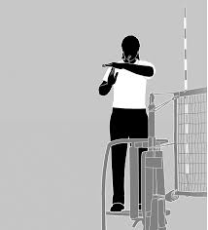
R2: Time outs
When the coach or captain calls for a time-out, the following sequence occurs:
The R2 double whistles (Tweet, Tweet), then moves to the side of the net of the team wanting the time-out, using Signal 19 at shoulder height, and indicate to the first referee the number of time outs each team has used.
  The R1 then mimics Signal 19 and extends the hand toward the team that has asked for the time out.
  The R2 reminds the timer to start the clock for one minute.
  Check with the scorer to make sure the time-out is recorded on the scoresheet for the appropriate team.
  Check the scoresheet for any individual score and team score discrepancies, and make sure the visible scoreboard agrees with the scoresheet.
19

Slide 3
R2: Time outs
  6. Check with the libero tracker to confirm the status of the libero - on or off the court.
  7. When 45 second have elapsed during the time-out, the second referee shall sound a double
  whistle (Tweet, Tweet) to remind teams to return to the court. At 60 seconds, the timer shall
  sound the audio signal to end the time-out. (For multiple courts the R2 may end the time-out
  with a long whistle.) The R2 indicates the number of time-outs used holding the signal with
  hands head high. Informs the coach(s) if two time-outs are used and gives the ready-to-play
  signal to the R1.
  When both teams are clearly ready to play prior to the 60 seconds, the R2 instructs the timer
  to stop the clock and whistles two short blasts, to confirm that everyone is ready to resume
  play.
  9. The R2 then instructs the timer to sound the horn, moves to a position on the receivers' side of
  the net with whistle in mouth, and gives the court back to the first referee.

Slide 4
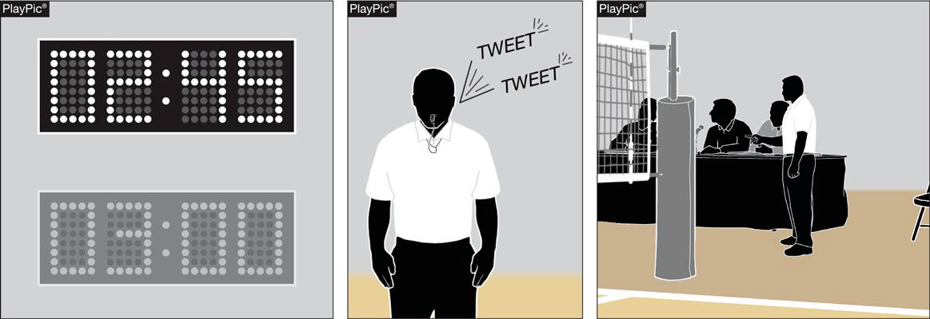
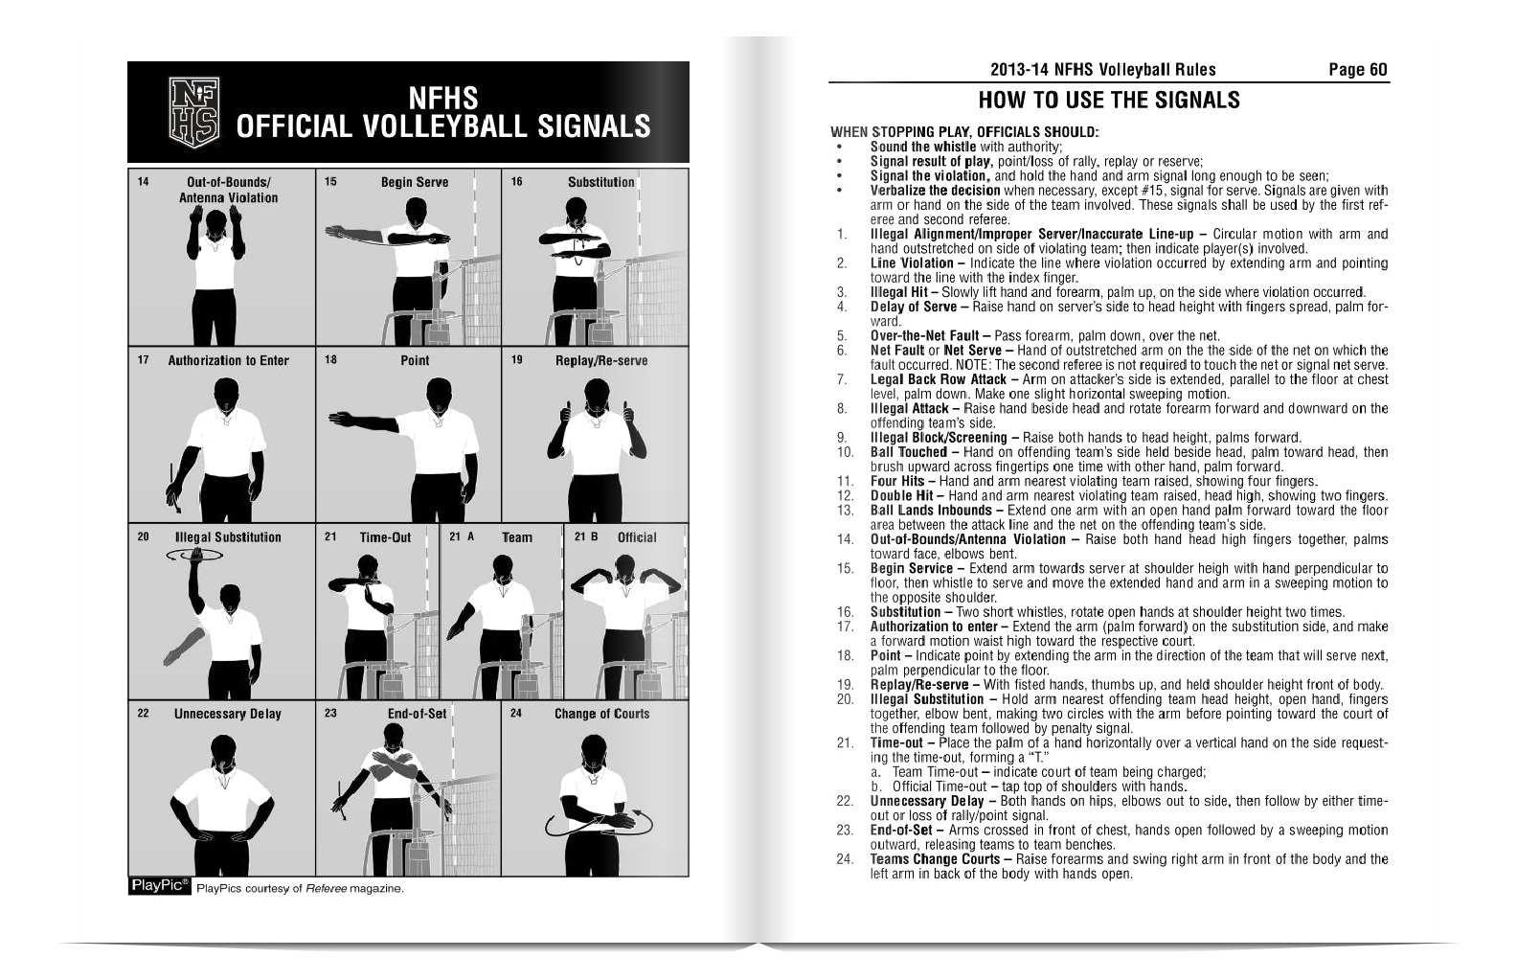
Substitution by the R2: Single substitution
When a player enters the substitution zone between the attack line and the center line or the coach calls for substitution, the R2 is called into action. These are the steps:
1. The R2 issues two short tweets of the whistle while using signal 15.
2. The R2 steps back toward the table so the table can see the numbers of each player and gets out their lineup card.
3. The R2 confirms with the table either by verbally calling out the numbers or asking the table if they have the numbers while marking the substitution number on the R2 lineup card. The number of the player that is subbing is called first and the number of the player leaving the court is called last. EX. 4 for 12 meaning 4 has entered the sub zone and 12 is leaving the court.
15
16

Slide 5
Substitution by the R2: Single substitution
4. The R2 then gives the signal 16 to enter the court.
5. After making sure the player enters into the correct place in the rotation, and the table is ready to resume; the R2 signals the R1 with outstretched arm and open palm facing the net they are turning the court back over to the R1. This signal indicates that the table and R2 are ready to proceed with the serve.
15
16

Slide 6
Substitution by the R2: Multiple Substitutions
When more that one substitution is being used, this is the procedure:
1. The R2 issues two short tweets of the whistle while using signal 15.
2. The R2 steps back toward the table so the table can see the numbers of each player and gets out their lineup card.
3. One set of subs enters the substitution zone, while the other set(s) wait in the libero replacement zone, until the first set has entered the court. When the first set has been signaled onto the court, the second set steps into the substitution zone. This procedure continues until all subs have entered the court.
4. If one sub decides they are not going in, they may return to the bench without penalty as long as they have not entered the substitution zone. Once they enter the substitution zone they will either enter the court or be given a yellow card for unnecessary delay. (Red card - if this happens more than once in a SET, not a match)
15
Net
12
4
6
12

Slide 7
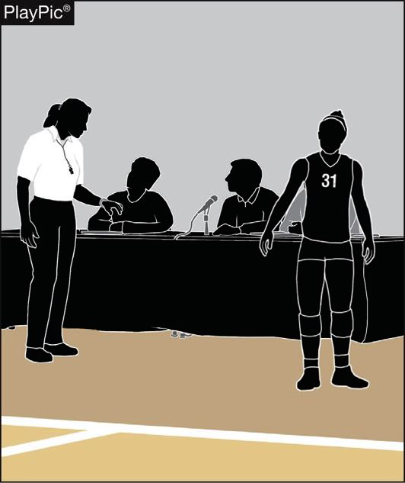
Substitution by the R2: Multiple Substitutions
5. The R2 confirms with the table either by verbally calling out the numbers or asking the table if they have the numbers while marking the substitution number on their lineup card. The number of the player that is subbing is called first and the number of the player leaving the court is called last (EX. 4 for 12 meaning 4 has entered the sub zone and 12 is leaving the court.) This procedure continues until all substitutions have entered the court.
6. The R2 then gives the signal 16 to enter the court.
7. After making sure the player enters into the correct place in the rotation, and the table is ready to resume, the R2 signals the R1 with outstretched arm and open palm facing the net they are turning the court back over to the R1. This signal indicates that the table and R2 are ready to proceed with the serve.
8. The R2 goes to the receiving side of the court so the service can begin.

Slide 8
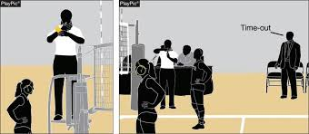
Unnecessary Delay
Any action by a team or team member that causes a delay in the start or resuming of play within a set constitutes an Unnecessary delay. An unnecessary delay includes but is not limited to :
Delay by a team not being immediately ready to start play when directed by the first referee
Delay resulting from a substitute attempting to enter (Ex. A player runs into the sub zone and realizes they are not suppose to be subbing at that moment, then they run back to the bench. Before the player had to enter the court but now a yellow card is issued and the sub returns to the bench. No further action can occur.
Delay when a player is in the set wearing illegal equipment. (EX. earrings, necklace, etc.)
Delay in resuming play due to a coach/captain making excessive requests for the serving order
An illegal substitute attempting to enter the set. (Remember unless the player runs into the sub zone, they can go back to the bench, no penalty.)
An Illegal replacement attempting to enter the set (illegal alignment once signal for serve is initiated.) This could be 6 goes in for 8 and they have already subbed in for 14 who is not in that rotation.
A team repeatedly using an improper substitution procedure. (Let’s say the players repeatedly go behind the attack line instead of in front of the attack line . Another example, they don’t wait to be sent in by the R2, they just pause at the attack line and go in before the R2 authorizes.) (WARN first)
A coach does not make a decision about an injured player within 30 seconds (11-4-1) (Please be very respectful of the downed player and coach at this time. Walk over and ask the coach, “What do you think you want to do with this player?”

Slide 9
Unnecessary Delay
Any action by a team or team member that causes a delay in the start or resuming of play within a set constitutes an Unnecessary delay. An unnecessary delay includes but is not limited to :
i. Delay in returning to play after a time-out, or delay caused by cleaning up liquid or other substance used by the team(s) during a time-out
j. Team conferring during a time-out at a location other than the team bench or court area
k. A team requesting a time-out in a set after it has take its allotted time-outs. (R2 always confirm with the table the number of time-outs remaining so you don’t give a time-out and then have to penalize for too many time–outs. If the coach asks for a time-out and you know they have used their allotted two, just shake your head or say they are all gone. Most coaches have forgotten they have used all their time-outs and their bench will confirm no more time-outs.)

Slide 10
Unnecessary Delay
Any action by a team or team member that causes a delay in the start or resuming of play within a set constitutes an Unnecessary delay. An unnecessary delay includes but is not limited to :
l. A libero entering the court outside the libero replacement zone. (This could also be the player being replaced or returning to the court going outside the replacement zone which is between the attack line and the end line.)
m. Substitution denied by the R2 after the request has been recognized (whistled) due to being illegal
n. Improper request for a substitution, time-out or line-up check that is acknowledged (whistled) by the referee.
Notes:
Yellow card is on the back of the hand on the side of the team receiving the yellow card. The R2 shows the yellow card to the R1 and the R1 is the official that issues the yellow card. The R2 turns to the table and says “YUD( yellow unnecessary delay) on C (coach) at and write the score their score first.

Slide 11
Unnecessary Delay Penalty
If a team has committed an unnecessary delay, the R2 moves to the offending team’s side of the net.
The R2 holds the penalty card in the hand closest to the non-offending team and placed against the back of the wrist of the other hand, which is held at head height, palm facing in on the side of the offending team.
The R1 administers the card in the same manner.
When the R1 initiates an administrative unnecessary delay, the R2 does not repeat the procedure.
Notes:
Yellow card is on the back of the hand on the side of the team receiving the yellow card. The R2 shows the yellow card to the R1 and the R1 is the official that issues the yellow card. The R2 turns to the table and says “YUD( yellow unnecessary delay) on C (coach) at and write the score their score first.

Slide 12
Unnecessary Delay Penalty
The R2 shall direct the scorer to record the proper notations and verify that the scorer has recorded them on the scoresheet. EX. For a yellow card, the scorer records in the comment section under the offending team: YUD (12-16) YUD (yellow unnecessary delay) (12-16) with score of the offending team being listed first.
Remember that the yellow unnecessary delay card only last for one set and does NOT cause the coach to have to sit. The YUD can be administered again in the next set and the next, BUT if two incidents happen in one set THEN a red unnecessary card is administered and loss of rally/point is awarded to the opponent. Remember a RUD still does not cause the coach to sit.
Notes:
Yellow card is on the back of the hand on the side of the team receiving the yellow card. The R2 shows the yellow card to the R1 and the R1 is the official that issues the yellow card. The R2 turns to the table and says “YUD( yellow unnecessary delay) on C (coach) at and write the score their score first. If a Red unnecessary delay is administered then the scorer record RUD (12-17) and a loss of rally/point is awarded.

Slide 13
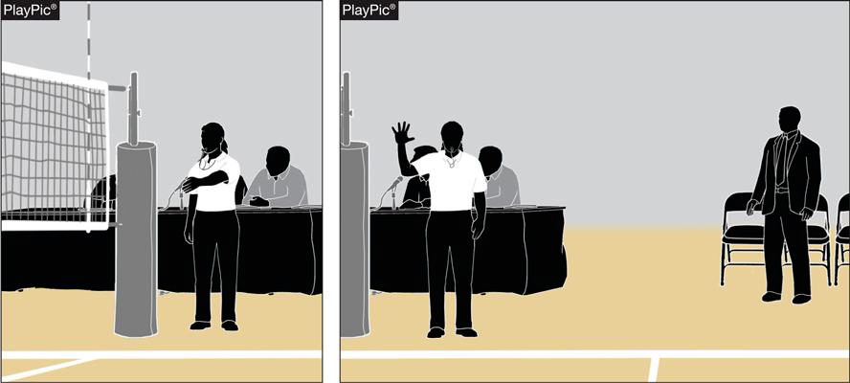
R2 in the net call
When the R2 realizes that a player has touched the net, the following sequence occurs:
The R2 double whistles, tweet, tweet (This double whistle distinguishes the R2’s call from the R1’s single longer whistle).
The R2 steps to the side of the offending player that is in the net, with open palm little finger on bottom thumb on top the R2 stretches out their arm to the net but not touching the net.
The R2 then signals to the R1 the number of the player that was in the net

Slide 14
R2 in the net call
4. The R1 then awards the point and gives the number of the player in the net to the coach.
(Remember, if a player goes over the center line, the number of the player is not necessary to be given in a center line violation.)

Slide 15
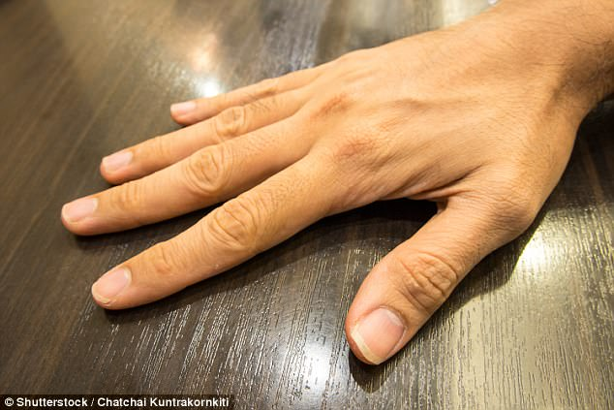
R2: Over the center line call
When the R2 recognizes that a player has crossed over the center line completely with no part of their foot or hand over the center line.
Remember the hand or foot must be completely across the center line as in the second image and Knee, head, bottom or any other body part is considered illegal over the centerline.
Illegal, over the center line.
Legal, Play on!

Slide 16
R2 OVER THE CENTER LINE VIOLATION call
When the R2 realizes that a player has crossed the center line, the following sequence occurs.
The R2 double whistles (tweet, tweet). The R2 steps to the side of the net where the player went over the centerline. The R2 points at the center line.
The R1 awards the point to the correct team and then mimics the center line signal.
Remember that it is not necessary to give the number of the player that has crossed the center line.

Slide 17
Introductions and National Anthem Protocol
At the end of the timed warm-up, both referees and the two line judges walk across the court.
The R1 and one line judge should be on the left side of the net (looking from the officials’ table), R1 is closest to the net.
The R2 and one line judge should be on the right side of the net (looking at the officials’ table), R2 is closest to the net.
The line judges flags should be placed on the referee stand.
All four officials should face the flag and stand at attention during the National Anthem.
All four officials should face the court during player introductions.
At the completion of player introductions, the R1 should take a step toward the court, whistle and beckon both teams onto the court to shake hands(if hands are not to be shaken, the R1 can motion for the teams to go to the bench area).
The line judges go to their respective corners with their flags.
The R1 takes a position on the referee’s platform while the R2 crosses the court to check the lineups.
LJ
R1
R2
LJ
NET
NET
LJ
R1
R2
LJ

Slide 18
Hope these reminders make your season go more smoothly
The End

